Slide 1
BRAIN TUMOR DETECTION USING MACHINE LEARNING

Slide 2
CONTENTS
Objective
Introduction
Proposed System
Tools & Technologies
Result
Conclusion
Future Scope
Biography

Slide 3
ABSTRACT
Medical imaging is gaining importance with an increase in the demand for automated, reliable, fast and efficient diagnosis which can provide insight into the image better than human eyes. The brain tumor is the second leading cause for cancer-related deaths in men age 20 to 39 and leading cause cancer among women in the same age group. Brain tumors are painful and suld end in various diseases if not cured properly.

Slide 4
Abstract
This paper discusses a deep learning technique that can detect the type of tumor using Brain MRI Images . The pipeline includes Data Augmentation Techniques to increase the size of the dataset as well as to add randomness to the dataset. We used a pre-trained deep learning model EfficientNetB0 from EfficientNet family which was trained on Imagenet dataset and then fine-tuned.
Keywords : Convolutional Neural Networks, MRI,
Deep Learning, EffiecientNetB0, Feature Extraction

Slide 5
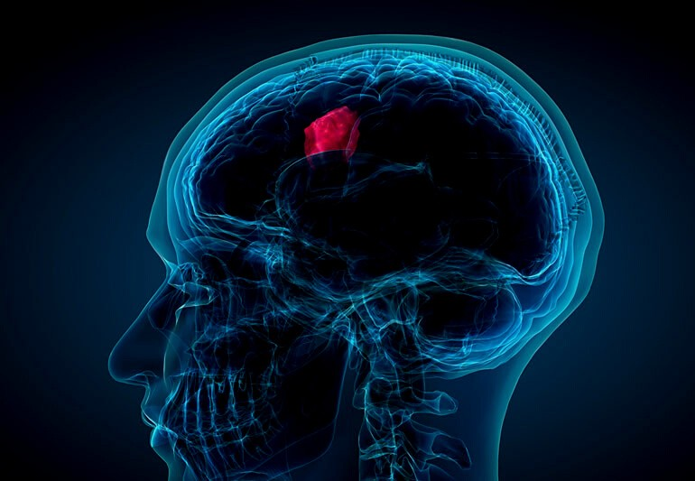
Introduction
The second most important cause of death according to the world health organization is cancer, and there are about 9.6 million deaths in 2021 because of cancer. Globally, about 1 out of every 6 death from cancer.

Slide 6
Types of Tumors
Glioma Tumor Meningioma Tumor Pituitary Tumor

Slide 7
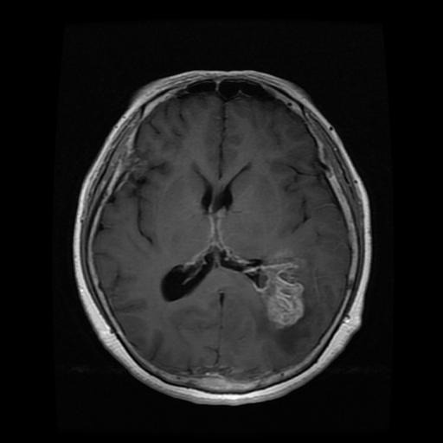
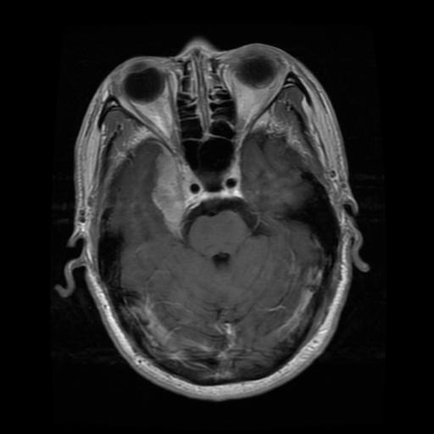
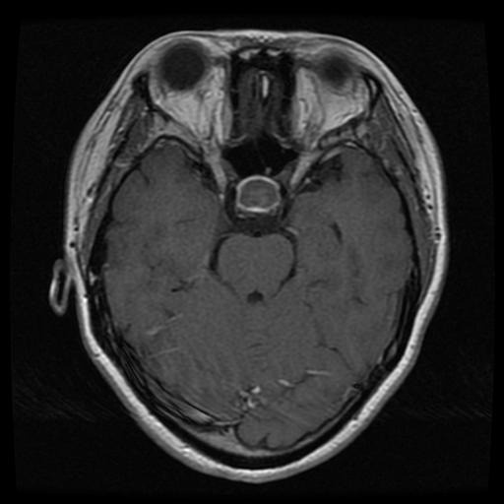
MRI Images of Tumors
Glioma Tumor Meningioma Tumor
Pituitary Tumor

Slide 8

Proposed System
Our proposed system pipeline consists of various steps:
Data Augmentation
Model Training
Evaluation and Prediction on a test image

Slide 9
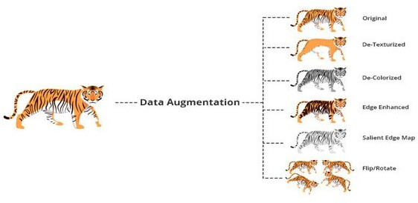
Data Augmentation
Data Augmentation are techniques used to increase the amount of data by
adding slightly modified copies of already existing data or newly created synthetic data from existing data.

Slide 10
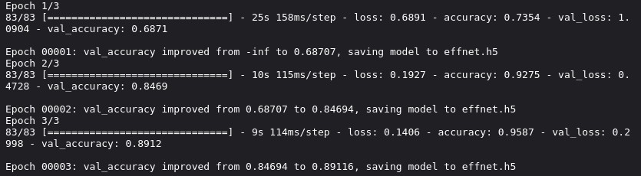
Model Training
Our dataset consists of 2937 images for training and 327 images for validation purposes. We fine-tuned the EffecientNetB0 model by adding a fully connected layer to it and then trained it for 3 epochs based on categorical crossentropy loss and Adam optimizer.

Slide 11
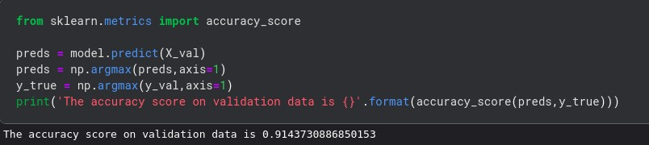
Evaluation
Upon training our model, the evaluation phase comes to play.
The accuracy score on validation data is 91.4% while the score on training data is 95.8% indicating that we didn't overfitted the model.

Slide 12
Tools & Technologies
Python Tensorflow OpenCV Deep Learning
Convolutional Neural Networks

Slide 13
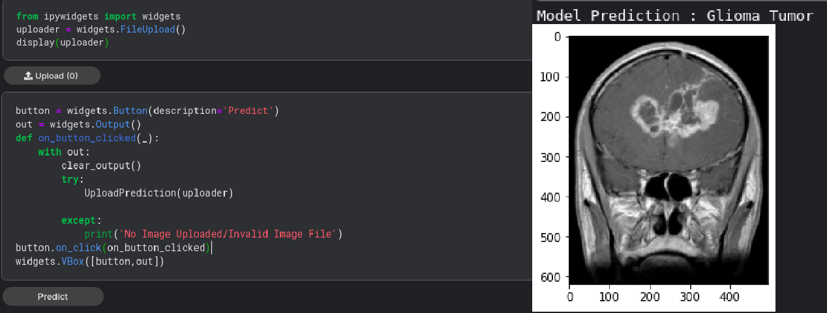
Result
The User can upload the MRI image to the model by clicking the Upload button as shown below and gets the result by clicking the Predict Button.

Slide 14
Conclusion
By using this software of Brain Tumor Detection using Deep Learning, we are able to detect the three types of tumors meningioma, glioma, and pituitary based on the pre-trained EffiecientNetB0 model. Once the tumor is detected then the treatment method will be decided by the doctor and the treatment will be given to the patient.

Slide 15
Future Scope
The future enhancements for this project are mentioned as :- Development of Web application which is accessible to everyone.
Embedding this software in MRI Scanners to detect the type of tumor instantly without examining by a Doctor.

Slide 16
Bibliography
https://www.kaggle.com/datasets/sartajbhuvaji/brain-tumor- classification-mri
Mingxing Tan, Quoc V. Le, et al. “ EfficientNet: Rethinking Model Scaling for Convolutional Neural Networks”. https://arxiv.org/pdf/1905.11946.pdf
https://www.tensorflow.org/

Slide 17






Thank You

